Slide 1
Factors Associated with Eviction Rate King County, WA 2011-2016 2019 SDSS Hackathon Isabel Ma – Quality Engineer, LexisNexis Risk Solutions, MN Chuchu Cheng – PhD student, Quantitative Psychology, Boston College Ramzi W. Nahhas, PhD, Manager, Data Sciences, Ventech Solutions, Columbus, OH

Slide 2
Research questions
Has the eviction rate changed over time?
What factors are associated with eviction rate?
What predictors of eviction rate have changed over time?
Are the relationships between predictors and eviction rate changing over time?

Slide 3
Data Sources
American Community Survey
Census-level (398 census tracts)
Population
Median gross rent
Median household income
Rent burden
Race/ethnicity
5-year averages
(e.g., 2011 values are based on 2007-2011)
Evictions Lab, Princeton University
Eviction rate
(# per 100 renter-occupied households)
Poverty rate
% renter occupied households
Median property value

Slide 4
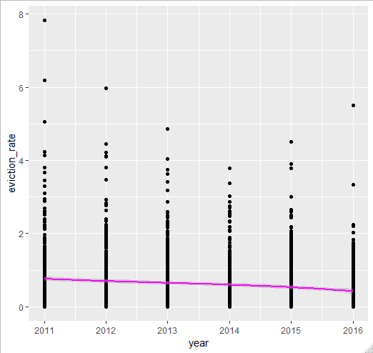
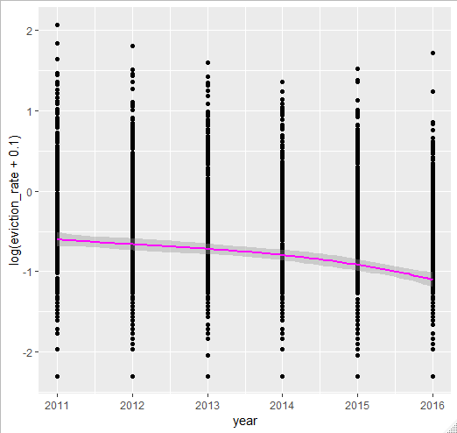
Eviction rate: Decreasing from 2011-2016

Slide 5
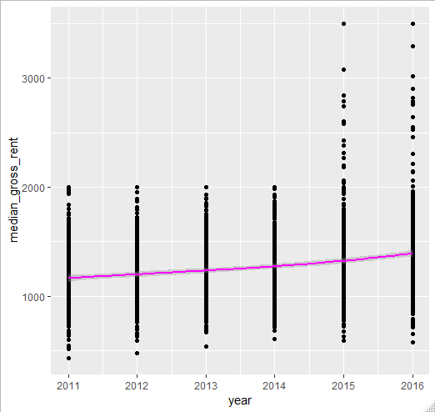
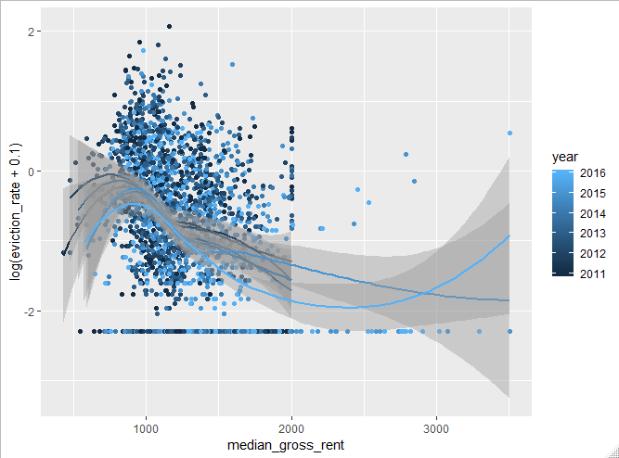
Median Gross Rent

Slide 6
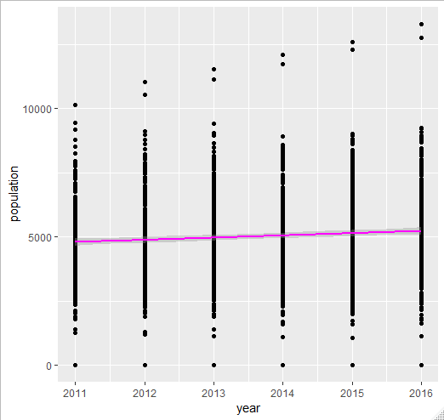
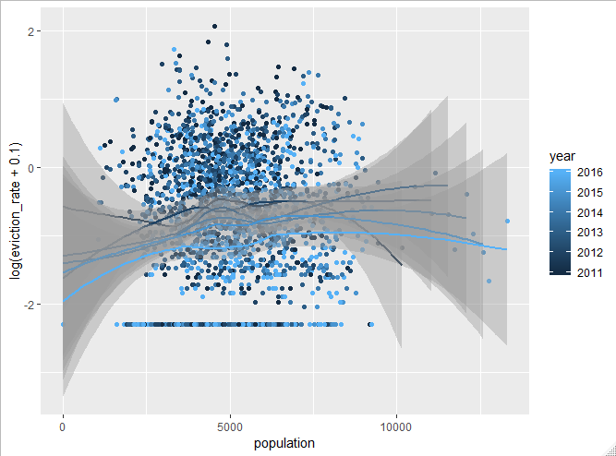
Population

Slide 7
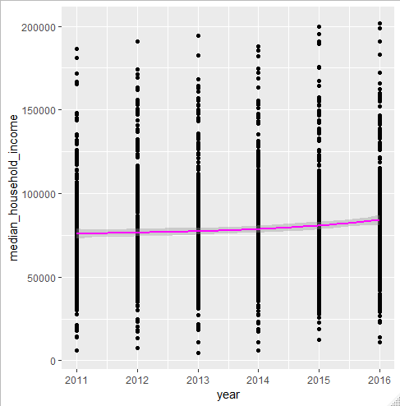
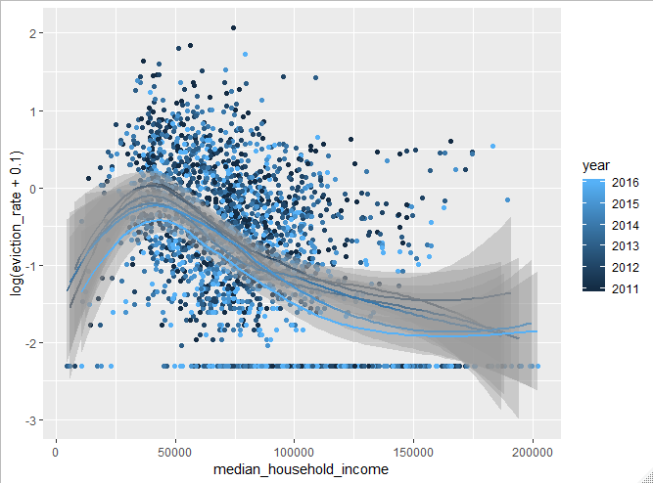
Median Household Income

Slide 8
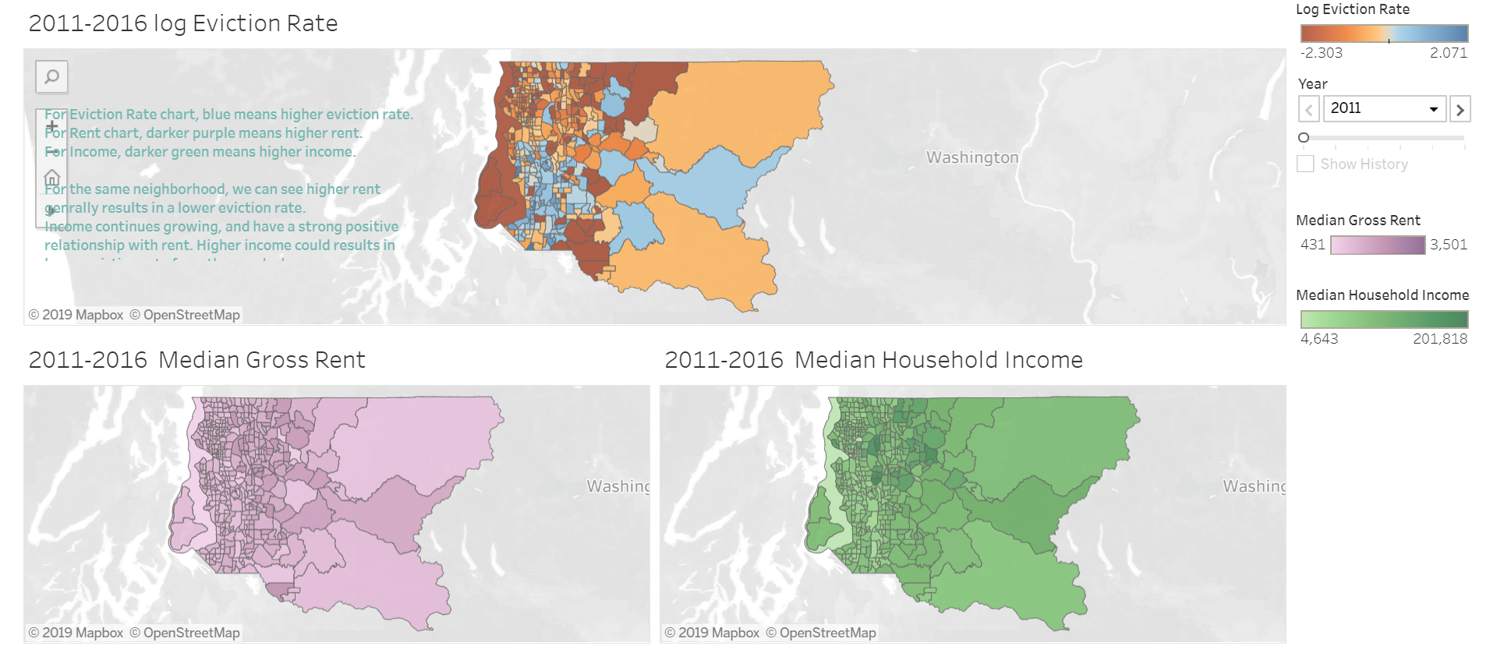
Geographic Distribution of Variables
Geographic Plots

Slide 9
Eviction Rate vs. Predictors
Feature engineering
Log-transformation
ln(Eviction rate + 0.1)
ln(Poverty rate + 1)
ln(Median property value + $100,000)
Logit-transformation
Race/ethnicity variables (%)
ln[ (p + 0.001) / (1 – p + 0.001)]
Modeling
Linear regression
Test time x predictor interactions
Plot predictor regression coefficients vs. time
Variable importance

Slide 10
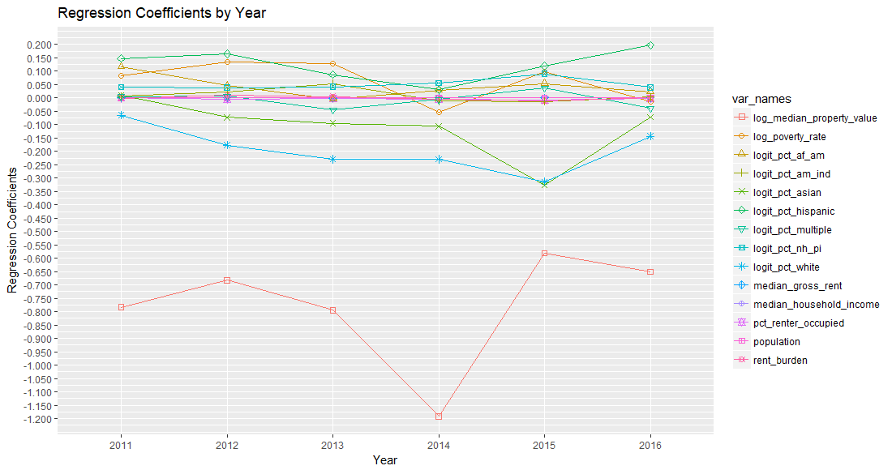
Are the relationships between predictors and eviction rate changing over time?

Slide 11
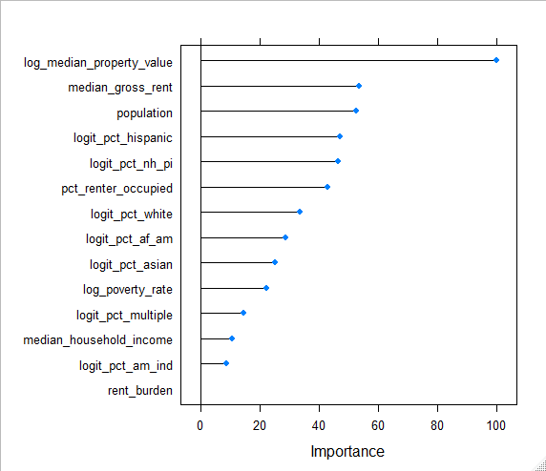
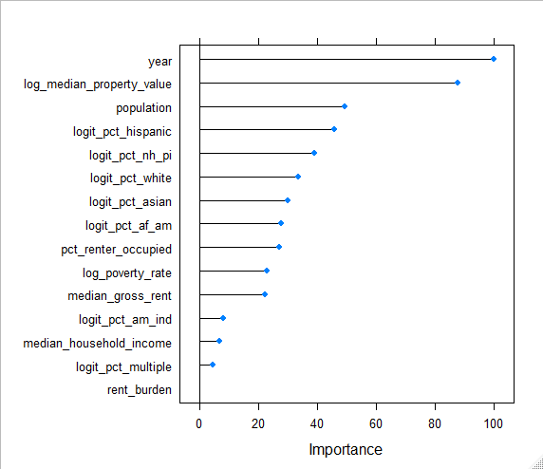
Variable Importance

Slide 12
Variable Importance

Slide 13
Conclusions
Has the eviction rate changed over time?
Yes, decreasing
What factors are associated with eviction rate?
Most important: unmeasured factors changing with time, median property value
What predictors of eviction rate have changed over time?
Increasing median gross rent (associated with decreasing eviction rate)
Increasing population (associated with increasing eviction rate)
Increasing median household income (associated with decreasing eviction rate)
Increasing % Asian (associated with decreasing eviction rate)
Are the relationships between predictors and eviction rate changing over time?
No

Slide 14
THANK YOU!
Any questions?

